Slide 1
TAKING INVENTORY
alliancewealthadvisors.com

Slide 2
PERSONAL INFORMATION
This workbook is designed to help you collect and organize your financial information.
Your Name | Annual Income | Employer | Tax Filing State | Date of Birth
Your Partner’s Name | Annual Income | Employer | Relationship to you | Date of Birth
Children, Dependents, or Other Beneficiaries | Relationship | Date of Birth

Slide 3
GOALS
Financial planning can mean different things to different people, but there are certain characteristics all plans should have in common. Working with a team of advisors who deeply understand your situation and the way you think about money is essential. It is also not a one-time exercise, but an ongoing strategic process that changes as your life does.
Next 12 months
5 years
10 years +
Anything else you would like to share with our team?

Slide 4
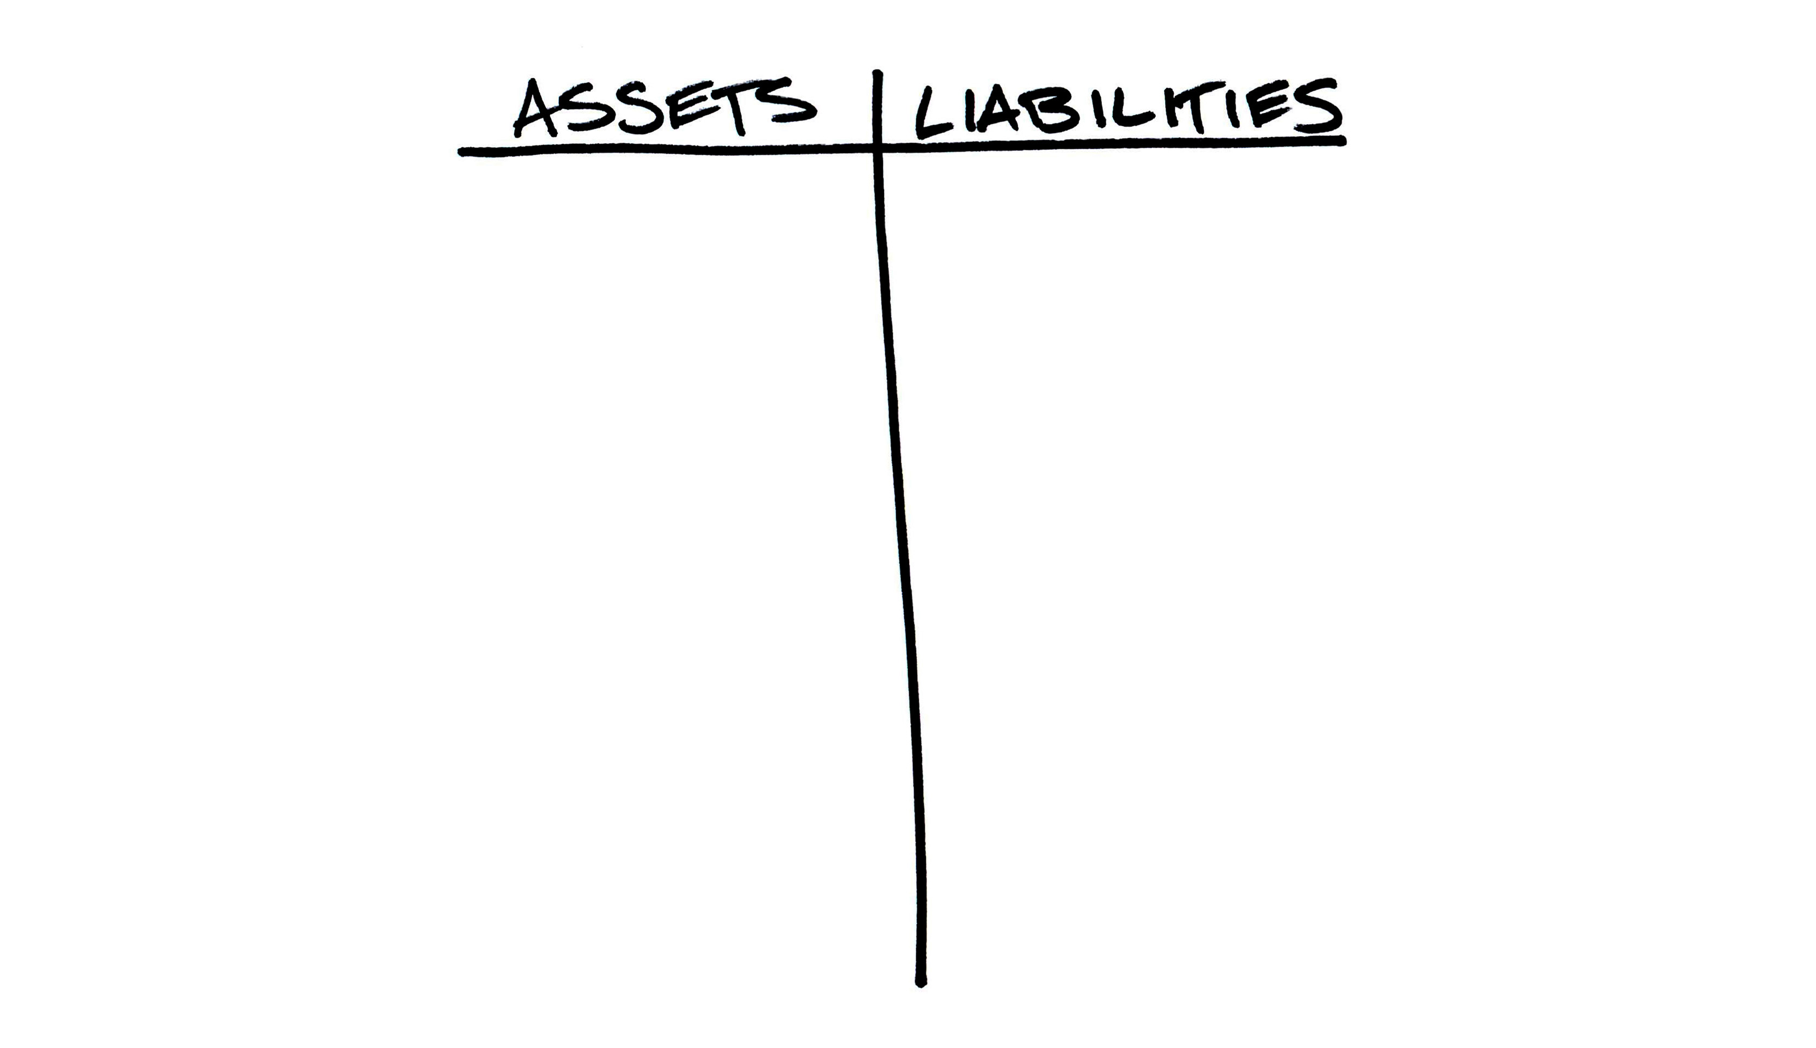
TAKING INVENTORY
We must be willing to be honest about our current situation before we can change it. Before you set financial goals about where you want to be in one, five, or twenty years, you must first understand where it is you are today.
As Peter Drucker famously said, “you can’t manage what you can’t measure”.

Slide 5
LIABILITIES

Slide 6
LOANS AND CREDIT CARDS
Account Title | Balance | Type | Payment | Interest Rate
Example: Tom & Mary Smith | $500,000 | Mortgage | $2,700/month | 5.00%
Most common account types:
Lines of Credit | Credit Cards | Mortgage | Student Loans | Auto Loans | Installment Loans
Do not have loans or credit cards

Slide 7
ASSETS

Slide 8
BANK ACCOUNTS
Account Title | Balance | Type | Contributions | Goal
Example: Tom & Mary Smith | $25,000 | Savings | $500/month | Short-term
Most common account types:
Checking Account | Savings Account | Money Market Fund | Certificates of Deposit
Do not have bank accounts

Slide 9
EMPOLOYER-SPONSORED ACCOUNTS
Account Title | Balance | Type | Contributions | Goal
Example: Tom Smith | $250,000 | 401(k) | $800/month | Long-term
Most common account types:
401(k) | 403(b) | Roth 401(k) | 457 Plan | Deferred Compensation
Do not have employer-sponsored accounts

Slide 10
INVESTMENT ACCOUNTS
Account Title | Balance | Type | Contributions | Goal
Example: Tom & Mary Smith | $100,000 | Brokerage account | $500/month | Long-term
Most common account types:
Brokerage accounts | Trust accounts | Health Savings Accounts | 529 Plans | UGMA accounts
Do not have investment accounts

Slide 11
LIFE INSURANCE
Owner | Death Benefit | Policy Expiration | Cash Value | Premium
Example: Tom & Mary Smith | $10,000 | Savings | $100/month | Short-term
Most common account types:
Term Insurance | Permanent Insurance
Do not have life insurance

Slide 12
OTHER ASSETS
Asset Name | Type | Value
Our Home | Primary Residence | $500,000
Most common other asset types:
Real Estate: Primary Residence | Secondary Residence | Investment Property
Business Assets: Sole proprietor | LLC | S-Corp | Partnership
Stock Options: Restricted Stock Unit | Incentive Stock Option | Non-qualified stock option
Do not have other assets

Slide 13
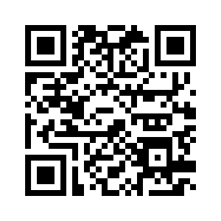
FINANCIAL STATEMENT UPLOAD
Please copy and paste the link below to upload your statements to our team. alliancewealth.sharefile.com/share/filedrop OR Scan QR code

Slide 14
HOUSEHOLD LIVING EXPENSES
Please estimate all your household living expenses
EXCEPT for mortgage, loans, insurance premiums, and systemic savings.
Estimated amount per month

Slide 15
INVESTOR EDUCATION

Slide 16
ASSET LOCATION
The information on this slide is for informational purposes only.

Slide 17
ASSET LOCATION
This should be thought of as a rainy-day fund, and so taking little to no risk with the money you allocate here makes sense.
By this we mean being focused on cash and having it be accessible quickly. This ensures you have options as things come up in life.
Should be considered a “life buffer”
Differs depending on your own personal situation, but a good general rule is enough cash on hand to cover anywhere from 3-12 months of expenses
Allows you to avoid getting caught needing to use debt excessively in an emergency and avoid selling investments to fund expenses
Examples: Checking and savings accounts, money market funds
The information on this slide is for informational purposes only.

Slide 18
ASSET LOCATION
This bucket should not have too much cash due to the dangers of inflation over time, but the risks you are taking here should be carefully understood. Liquidity should still be a priority in case your situation changes. You should have access to these funds to remain flexible.
Invested to ensure your money’s purchasing power keeps up with inflation
Can be invested in a combination of preservation, income, and growth strategies depending on your situation
Examples: individual or joint investment accounts, revocable trusts, health savings accounts
The information on this slide is for informational purposes only.

Slide 19
ASSET LOCATION
This should be where your retirement accounts and long-term money focused on building your wealth are positioned. It is where you should take the most risk when you are younger and adjust accordingly as you get closer to retirement. If you fund the first two buckets sufficiently, you will not have to worry as much about market cycles. You can let your assets remain uninterrupted to participate in long-term compounding. By not interrupting that process, the results have the potential to be truly remarkable.
Should be focused on growth-oriented strategies to build long-term wealth the younger you are
Once you build a strategy that fits your goals and personal situation you should not make frequent changes
Examples: 401(k), Traditional IRA, Roth IRA, SEP IRA
The information on this slide is for informational purposes only.

Slide 20
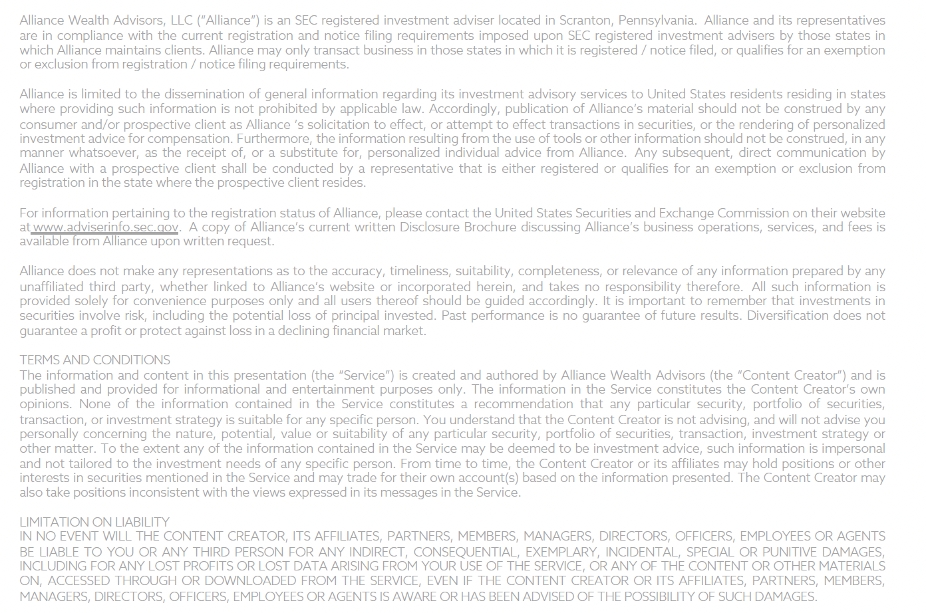
DISCLOSURES

Slide 21
alliancewealthadvisors.com

